Slide 1

Lesson 4: PRISMS AND CYLINDERS Solids for which V=Bh
Week 6
Math 13
Solid Mensuration
Notes:
Week 6

Slide 2
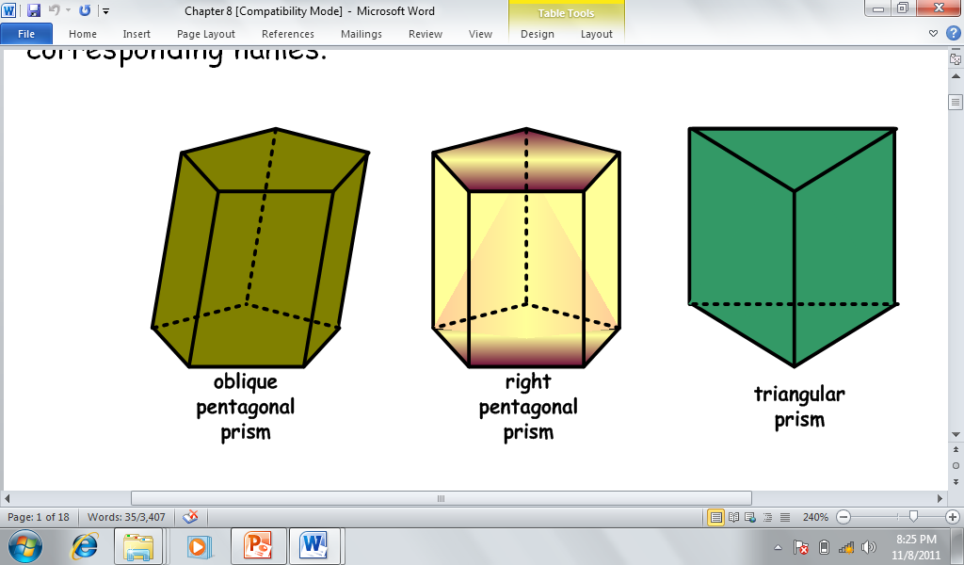
A prism is defined as a polyhedron with two congruent bases that lie in parallel planes, and whose every section that is parallel to a base has the same area as that of the base.

Slide 3
A right prism is a prism whose lateral faces or lateral edges are perpendicular to the two bases.
A regular prism is a right prism whose bases are regular polygons. If the base is a regular polygon of n sides then the prism contains n number of congruent lateral faces which are rectangles.
An oblique prism is a prism whose lateral faces or lateral edges are not perpendicular to its bases. Its lateral faces are parallelograms.

Slide 4
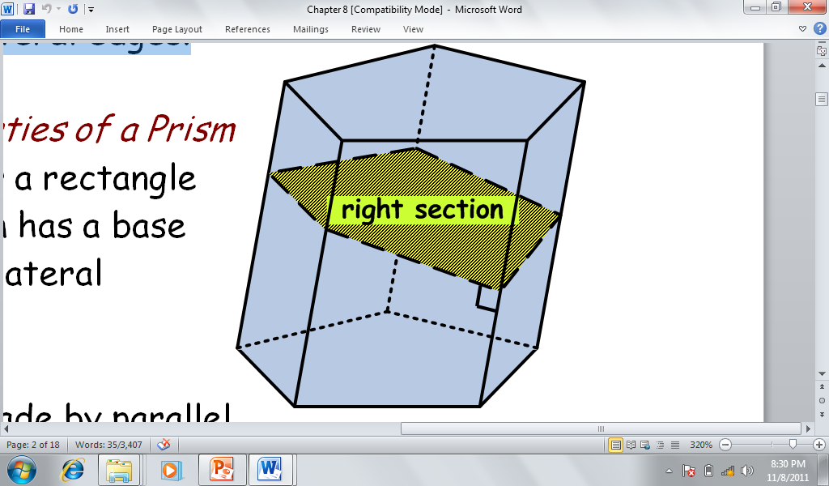
A right section of a prism is a section made by a plane perpendicular to one of the lateral edges.
An oblique section is made by a plane oblique to one of the lateral edges.

Slide 5
Surface Areas
The lateral area of a prism is the product of the perimeter P of a right section and the length e of a lateral edge.
Total Surface Area:
where B is the area of one base.

Slide 6
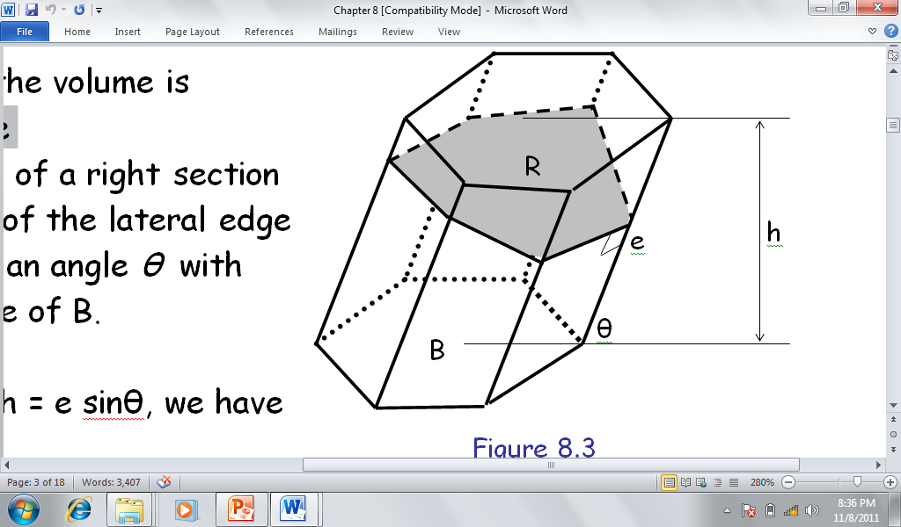
Volume of Prism
V = Bh

Slide 7
A rectangular solid, also known as rectangular parallelepiped is a polyhedron with two rectangular bases and lateral edges that are perpendicular to the bases.
h
w
l

Slide 8

Rectangular Solids
Diagonal :$d=\sqrt{l^{2}+w^{2}+h^{2}}$
Surface Area: $TSA=2lw+2lh+2wh$.
Volume: $V=lwh$..

Slide 9
A cube is a hexahedron whose 12 edges are all congruent.
d
s
s
s

Slide 10

Cube
Diagonal:$d=\sqrt{3}s$
Surface Area: $TSA=6s^{2}$
Volume: $V=s^{3}$.

Slide 11
A cylinder is the solid bounded by a closed cylindrical surface and two parallel planes cutting all the elements of the surface.
A circular cylinder is one whose bases are circles. It may also be thought of as a prism with two equal circular bases.
A circular cylinder is a right circular cylinder, if the height or the line segment drawn through the center of the bottom base connects the center of the top base. Otherwise, the cylinder is said to be oblique.

Slide 12
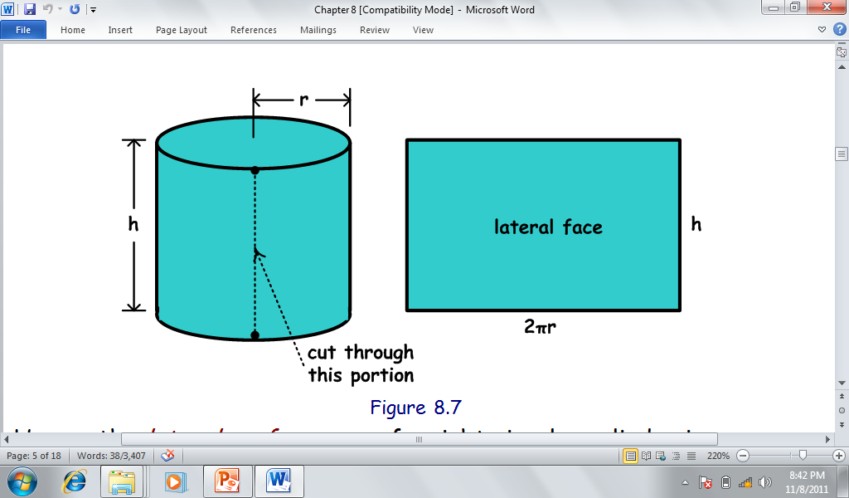
Surface Areas

Slide 13
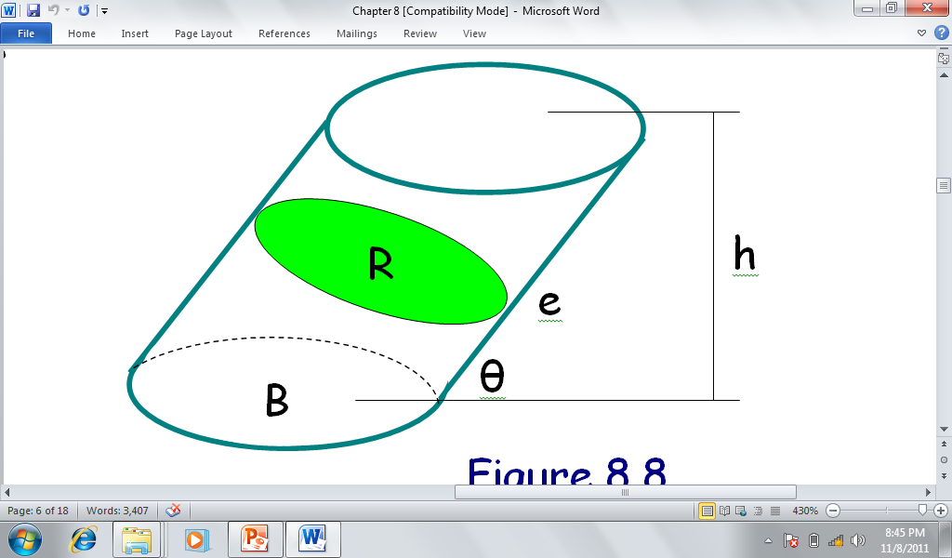
Volume of Cylinder

Slide 14
Sample Problems
EXAMPLE 2 Page 99: The trough in the figure has trapezoidal ends which lie in parallel planes. The top of the trough is a horizontal rectangle 6 ft by 16 ft and the depth of the trough is 4 ft.
How many cubic feet of water can it hold?
How many cubic feet of water does it contain when the depth of the water is 3 ft?
What is the area covered by water (wet portion of the container) with this height?

Slide 15
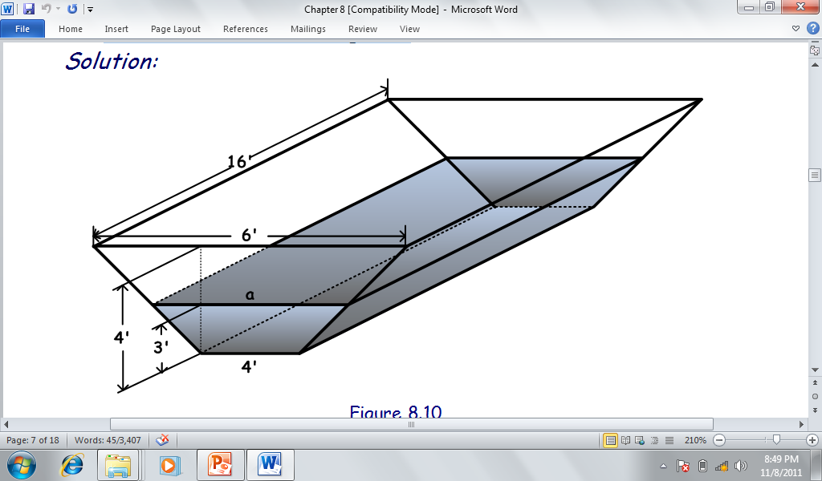

Slide 16
EXAMPLE: The right section of a prism is in the form of a regular hexagon whose apothem measures 5 cm. If the lateral area is 360cm², what is the length of the lateral edge of the prism?
ANS. 10.39 cm.

Slide 17
EXAMPLE 10: A cylinder with a volume of 576pi m³ is circumscribed about a square prism which has one side of the base that measures 8m. What is the altitude of the cylinder?
ANS: 18 m

Slide 18
EXAMPLE: The length of a rectangular solid is three times the width and the height is twice the width. Find the volume and the length of its diagonal if the total surface area is 198 in².
ANS: V=162 cu.in, d=11.22 in

Slide 19
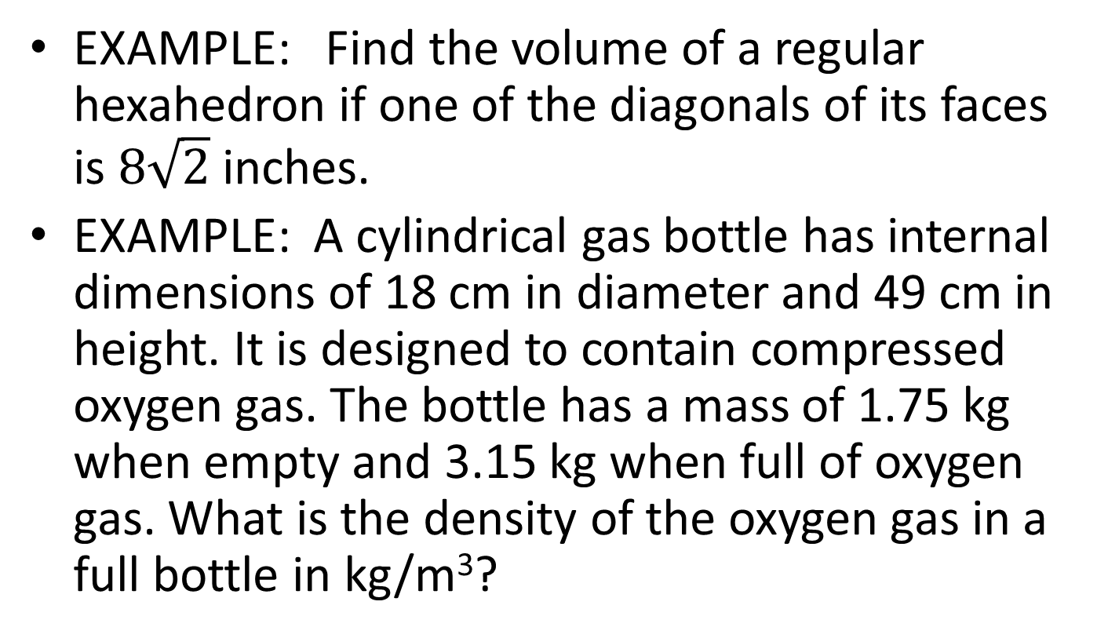
EXAMPLE: Find the volume of a regular hexahedron if one of the diagonals of its faces is $8\sqrt{2}$ inches.
EXAMPLE: A cylindrical gas bottle has internal dimensions of 18 cm in diameter and 49 cm in height. It is designed to contain compressed oxygen gas. The bottle has a mass of 1.75 kg when empty and 3.15 kg when full of oxygen gas. What is the density of the oxygen gas in a full bottle in kg/m³?

Slide 20
PROBLEMS
A cylindrical tank has a lateral surface area of 88 π cm² (not 8 π as what printed in the book) and a volume of 176π cm³. Find the base area. (#15 4.3 page 118)
2. What dimensions of a tin can of volume 54π cm³ should be produced if it is required that its height be equal to the diameter of its base?

Slide 21
PROBLEMS
3. One edge of an oblique prism forms an angle of 30⁰ with its projection on the plane of one base. If the lateral edge is 15 cm long and the base area is 20 cm², find the volume of the prism.
4. Each base of a right prism is a rhombus. The diagonals of a base are 12 and 6, and the altitude of the prism is 18. Find the volume and the lateral area.

Slide 22
Homework
EXERCISE 4.1: #1, 9, 17 pp. 102-104
EXERCISE 4.2: #7, 23 pp. 110-111
EXERCISES 4.3: #1-a, 13, 25, pp. 118-121

